Slide 1


Shahnaj Ullah
February 18, 2023

Slide 2

Outline
Executive Summary
Introduction
Methodology
Results
Conclusion
Appendix

Slide 3
Executive Summary
Data was collected through SpaceX REST API and web scraping from a Wiki Page table. To clean data we filtered for records specific to Falcon 9 launch records, we replaced missing payload records with its mean value. Initially the data was missing interpretable data as it had ID numbers, we retrieved records that are associated to those ID. We classified landing outcomes with binary numbers to represent successful/failed landing. We carried out analysis using SQL and data visualization. We used Folium and Plotly dash to gain interactive analytic insights. Lastly we used machine learning models to create a model that can predict the possibility of the first stage successfully landing for falcon 9 ship.
Our exploratory data analysis showed launches made from launch site KSC LC-39A had higher success rate. Booster version FT also had higher success rate along with payload masses ranging from 2000-3250kg had increased success odds.

Slide 4
Introduction
Companies are trying to make travelling to space accessible by making it affordable. If a launch is successfully executed, SpaceX is able to reuse its first stage components of Falcon 9 thereby making it significantly cheaper per launch in comparison to its competitors. The competitors can cost upwards of 165 million dollars for a launch whereas SpaceX is upwards of 62 million dollars.
Here, we would like to create a predictive model that can classify the landing outcome of a launch. We will use SpaceX's falcon 9 historical data to train the model. With this info we can estimate the cost of needed for the next launch knowing whether we can reuse the first stage from the launch.

Slide 5

Section 1

Slide 6
Methodology
Executive Summary
Data collection methodology:
SpaceX REST API was used to gather data on rocket used, payload delivered, launch specifications, landing specifications and landing outcome for SpaceX's launches.
Additionally, web scraping was used to gather more data on the Falcon 9 launches from a Wiki page's table. This web page contained useful data such as launch sites, flight number, payload mass, booster version and more.
Perform data wrangling
Describe how data was processed
Perform exploratory data analysis (EDA) using visualization and SQL
Perform interactive visual analytics using Folium and Plotly Dash
Perform predictive analysis using classification models
How to build, tune, evaluate classification models

Slide 7
Data Collection – SpaceX API
A get request was sent to a URL to target a specific endpoint of SpaceX's REST API which returns the data of past launches in the form of a list of JSON objects. The JSON objects was then converted to a dataframe using the json_normalize function.
This led to obtaining a dataframe who's records consisted of data represented by ID numbers in place of useful information. Several functions were created to send multiple get requests to the API again to extract actual data on the BoosterVersion, PayloadMass, Orbit, LaunchSite, Outcome, Flights, GridFins, Reused, Legs, LandingPad, Block, ReusedCount, Serial, Longitude and Latitude using the ID numbers from the rocket, payload, launchpad and cores dataset. These data were saved as a list and then saved as a dictionary to be converted to a pandas dataframe.
See process flowchart on slide

Slide 8
Data Collection – SpaceX API
Send get request to API
SpaceX REST API returns response
List of JSON objects
Convert to Pandas Dataframe using json_normalize()
Dataframe of data created with records of data being ID numbers
Decode list of JSON object to JSON
Send get request to API again to fetch data associated to launch site, payload and core information using their ID numbers from the dataset and save columns as list.
Combine columns to dictionary
Convert dictionary to pandas dataframe
Github API notebook URL:
https://github.com/ShahnajRUllah/Space_Y/blob/208a76df5c8bea68ee2397acaf0161e5fb3c2278/Data%20Collection%20API.ipynb

Slide 9
Data Collection – Scraping
Python's BeautifulSoup package was used to web scrape an HTML table from a Wiki page containing records associated to Falcon 9 launches.
The data was obtained by sending an HTTP request to the Wiki page's URL which returns a response with the HTML contents of the web page. Then a beautiful soup object was created to create an HTML parser which nested the HTML data to make it more navigable. The HTML parser was used to extract the relevant column headers and records using the find_all function on the table's HTML tag to save the each column as a dictionary. Then the dictionary was converted to a pandas data frame.
See process flowchart on slide

Slide 10
Data Collection - Scraping
Send HTTP get request to Wiki web page
Iterate through HTML table headers to parse column names
Navigate HTML tree using the find_all function to find the table containing Falcon 9 launch data
Obtain records of data for each columns by parsing table rows
Convert dictionary to pandas dataframe
Web page returns HTML response
Create soup HTML parser object using BeautifulSoup function
Create an empty dictionary using column names as keys
Github Webscraping notebook URL:
https://github.com/ShahnajRUllah/Space_Y/blob/master/Data%20Collection%20with%20Web%20Scraping.ipynb

Slide 11
Data Wrangling
The initial dataset from the API held records of ID numbers in the columns of rocket, payloads, launchpad and cores. These IDs are linked to useful launch data such as BoosterVersion, PayloadMass, Orbit, LaunchSite, Outcome, Flights, GridFins, Reused, Legs, LandingPad, Block, ReusedCount, Serial, Longitude and Latitude. A get request was sent to a different endpoint of the API again to extract those data using the ID numbers.
Using the data from the BoosterVersion we also filtered to remove any records not relevant to Falcon 9 from the dataframe.
Data collected through the REST API had some missing values in the PayloadMass and LandingPad columns as well. To deal with this we substituted the PayloadMass missing values by the mean of PayloadMass values and for the LandingPad it retained values of None to signify landing pads were not used.
Furthermore, we converted the mission outcomes to either successfully landed or unsuccessful landing of the booster using categorical classes of 1 or 0, with 1 meaning successful and 0 not. True Ocean, True RTLS and True ASDS are successful landing values and False Ocean, False RTLS, False ASDS , None ASDS and None None are unsuccessful.
GitHub Notebook URL:
https://github.com/ShahnajRUllah/Space_Y/blob/master/Data%20Wrangling.ipynb

Slide 12
Data Wrangling
Send get request to API using IDs from dataset of columns rocket, payload, launchpad and cores
Convert dictionary to pandas dataframe
Store response data as list for each new column
Combine columns into dictionary
1 - Get more data from API using ID numbers from initial Dataset:
2 - Remove record unrelated to falcon 9:
3 - Replace missing values in PayloadMass column:
Check and count Null records in each column of the dataframe using .isnull() and .sum() function
Ignore landingPad Null values to signify landing pads weren't used
Calculate mean of PayloadMass column, replace the Null values with its mean
New dataframe with only Falcon 9 launch data
Filter initial dataframe column BoosterVersion for records belonging to Falcon 9 only.
4 - Replace mission outcome with categorical class values of 1 or 0:
Create new column from the outcome columns and identify it as landing outcome
Create a set from landing outcome to identify the failed outcomes.
Classify the outcomes column to a new column landing class which categorizes the successful versus unsuccessful landing with values of 1 or 0.
Github Webscraping notebook URL:
https://github.com/ShahnajRUllah/Space_Y/blob/master/Data%20Collection%20with%20Web%20Scraping.ipynb

Slide 13
EDA with Data Visualization
Scatter plot: Flight Number vs. Payload Mass to see the odds of successfully landing increases with continuous launch attempts and the influence of the size of payload on the likelihood of the first stage returning.
Scatter plot: Flight Number vs. Launch Site to visualize correlation between selecting a particular Launch Site and successfully landing.
Scatter plot: Payload and Launch Site to visualize correlation between launching from a particular site with a specific payload mass.
Bar chart: Visualize correlation between orbit type and successfully landing.
Scatter plot: Visualize correlation between continuous launch i.e. Flight Number and Orbit type.
Scatter plot: Visualize correlation between Payload size and Orbit type.
Line plot: Visualize trends between successful landing and the year.
Github notebook URL:
https://github.com/ShahnajRUllah/Space_Y/blob/master/EDA%20using%20Data%20VIsualization.ipynb

Slide 14
EDA with SQL
Query list of all unique launch sites in the space mission
Query five records in which launch site begin with string 'CCA'
Query the total payload mass carried by boosters launched by NASA (CRS)
Query the average payload mass carried by booster versions F9 v1.1
Query the date in which the first successful ground pad landing outcome was achieved
Query the list of names of boosters that have successful landing in drone ship and a payload mass of greater than 4000kg but less than 6000kg
Query the count of the total number of successful and failed mission outcomes
Query the list of booster version names that have carried the maximum payload mass
Query the list of month, failed landing outcome in drone ship, booster version and launch sites for the months in the year 2015
Query the rank count of successful landing outcomes in descending order between the dates 04-06-2010 and 20-03-2017
Github notebook URL:
https://github.com/ShahnajRUllah/Space_Y/blob/master/SQLlite%20Exploratory%20Data%20Analysis.ipynb

Slide 15
Build an Interactive Map with Folium
Blue circle markers were used to identify the four mission launch sites.
All the launch outcomes were clustered by launch site and then further identified by green and red popup icon markers to signify successful and unsuccessful landing outcomes respectively. This can help identified if certain sites have higher success rate than others.
A mouse pointer object was also created to be able to hover over a point on the map and easily obtain the latitude and longitude of that location of interest. This was used to later identify the distance between the railways, highways, city and coast in a launch site's close proximity.
Lastly we identified the coast, city, highway and railway closest to launch site KSC LC-39A using a blue line to map the distance of these points. The distances were also calculated and marked on the map. This is helpful in understanding how sites are usually located i.e. for example far from cities or nearby coasts, etc.
GitHub notebook URL:
https://github.com/ShahnajRUllah/Space_Y/blob/master/Location%20site%20analysis%20with%20folium.ipynb

Slide 16
Build a Dashboard with Plotly Dash
Using plotly dash we were able to gain insights with regards to which launch sites experiences the most success in its launches. A dropdown menu was created allowing users to view either the number of successful launches across all the sites or to view the ratio in the number of successful versus failed launches of a given site.
Secondly, a scatter plot is also created to visualize the correlation between using a particular payload mass, a specific booster version and having a successful landing outcome. Using the dropdown menu we can select to gain the insight across all launch sites or a particular one. Additionally, a slider tool was added to narrow the x-axis payload mass range to get a closer look on the booster versions in the specified range.
GitHub space app URL:
https://github.com/ShahnajRUllah/Space_Y/blob/master/spacex_dash_app.py

Slide 17
Predictive Analysis (Classification)
Identify the Target variable Y using the Class column from the dataset. Save it as a pandas series.
Standardize the data to variable X using the transform() function and fit() function.
Split the dataset into training and test sets using the train_test_split() function. Use 20% of the data for the train split.
Test different training models to see which prediction model is best for classification prediction.
Create ML model object example, LR = LogisticRegression() object
Create Grid Search Object for the model using the GridSearchCV() function to search which hyperparameters finds makes the best predictions
Fit the model to the training datasets
Verify the best hyperparameters that was used by the model and its best score
Plot a confusion matrix to calculate the recall and precision of the model
Define ML model's possible hyperparameters to test
Determine the accuracy on the test set
Repeat the process for the Support Vector Machine Model, Decision Tree and K nearest neighbors. Compare which model is best in the end
First the Target and Feature variables were identified. Then the dataset was split into training and test datasets.
After the split of the dataset, we trained four different machine learning models to see which models made the best classification predictions for the landing outcomes. The models compared to was the Support Vector machine, Decision Tree, Logistic Regression and K nearest neighbor model.
We performed a grid Search to find out which hyperparameters is best for the models to yield the highest accuracy.
The recall and precision was calculated from each model's respective confusion matrix. The model with the highest recall and precision deemed the best model for our prediction.
The accuracy calculated using the best_score() function for each model was also compared in a bar chart to also determine the best model for our objective.
GitHub notebook URL:
https://github.com/ShahnajRUllah/Space_Y/blob/master/SpaceX_ML_Prediction.ipynb

Slide 18
Results from Data Visualization EDA
Result Summary from Data Visualization EDA
Launch site related observation:
Launch sites VAFB SLC-4E and KSC LC-39A shows a higher success rate in comparison to site CCAFS SLC-40.
Site KSC LC-39A has higher success with lower payload masses of below 5500kg while site VAFB SLC-4E is successful with payload masses lower than 10000kg. Site CCAFS SLC-40 experiences more success with heavy payloads of approximately 16000kg.
Orbit type related observation:
Orbit ES-L1, GEO and SSO have higher success rates versus orbit SO which has none.
Orbit LEO experiences an increased success rate as the launch attempt number increases, i.e. flight number.
Orbit LEO and ISS have higher successful landing rate with heavier payloads.
Yearly landing outcome trend shows the success rate increases after the year 2013.

Slide 19
Results from EDA using SQL
Result summary from EDA using SQL:
There are four launch sites in total. CCAFS LC-40, CCAFS SLC-40, KSC LC-39A and VAFB SLC-4E.
NASA (CRS) booster launched a total of 45596kg payload.
Booster version f9 v1.1 carried an average of 2534.67kg
First successful landing outcome in ground pad was on 22-12-2015
Boosters FT B1022, B1026, B1021.2 and B1031.2 have had successful landing on drone ships while carrying payloads between 4000-6000kg.
A total of 100 successful mission outcome was counted and 1 failed in flight
There were 12 B5 booster versions that carried the maximum payload.
In January and April 2015, there has been two failed drone ship landing outcomes both were launched from CCAFS LC-40.
There has been 10 landing outcomes with no attempts and 5 successful/5 failed drone ship landing as well. 3 successful ground pas landing, 3 controlled/2 uncontrolled ocean landing. 2 parachute failed landing and 1 precluded drone ship landing.

Slide 20
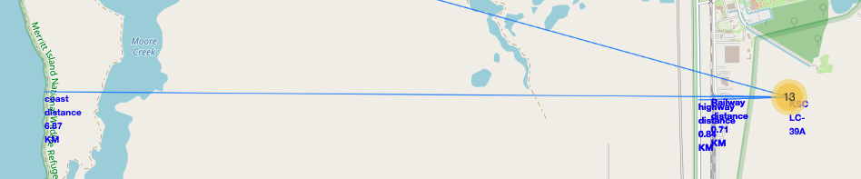
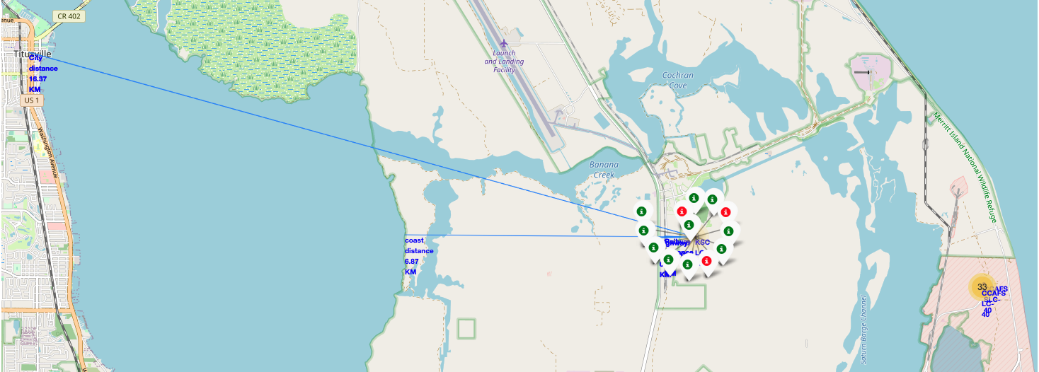
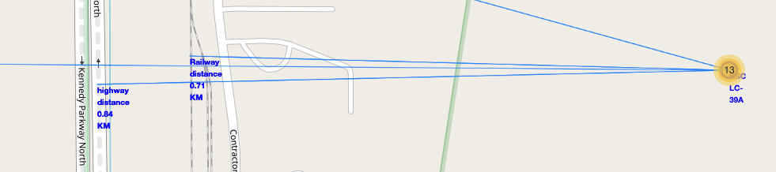
Results from Folium Interactive Map Analysis
From the interactive folium map we've highlighted the most popular launch site, i.e. KSC LC-39A. We can see the closest city is 16.37km away. The coast is 6.87km, and there is a highway and railway 0.84km and 0.71km away respectively.
Looking at all launch sites, the city tends to be further away from the site while they are all close to a coastline, a highway and railway.

Slide 21
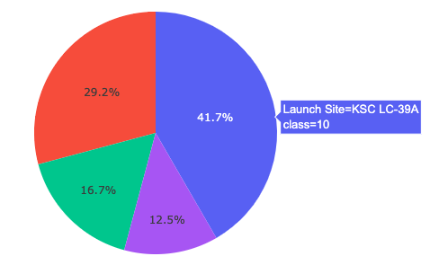
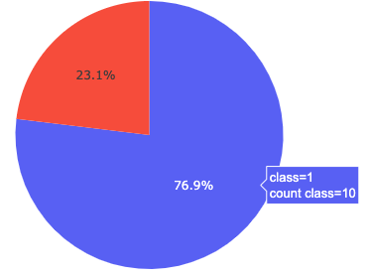
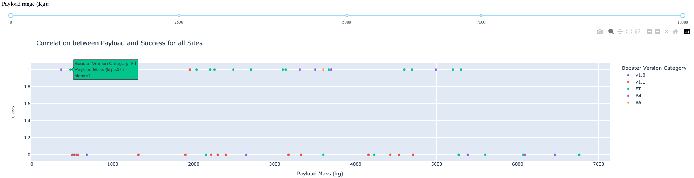
Results from Plotly Dash
Dash pie chart shows Launch site KSC LC-39A has the most success rate.
Dash scatter plot shows booster version FT has the most success and v1.1 has more fails. Payload masses between 1900-3700kg have higher success rate as well.

Slide 22
Results from Predictive Analysis
From our predictive analysis process we concluded the best model to make our classification prediction of whether a launch will successfully land or not is the Decision tree model with the hyperparameters set to the following:
criterion:entropy,
max_depth:8,
max_features:sqrt,
min_samples_leaf:2,
min_samples_split:2,
splitter:random.
This model exhibits a 89% accuracy.

Slide 23

Section 2

Slide 24
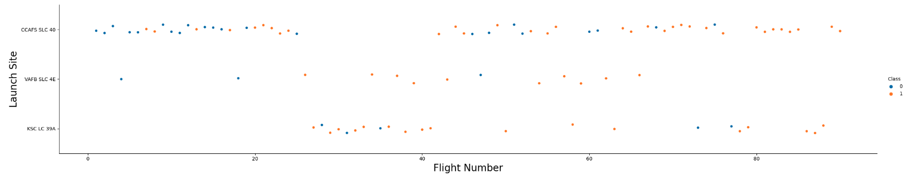
Flight Number vs. Launch Site
CCAFS SLC-40: 33/55 successful launches ~ 60% success rate
VAFB SLC-4E: 10/13 successful launches ~ 77% success rate
KSC LC-39A: 17/22 successful launches ~77% success rate
Launch sites VAFB SLC 4E and KSC LC-39A have a success rate of 77% in comparison to CCAFS SLC-40 which has a 60% success rate for landing successfully.

Slide 25
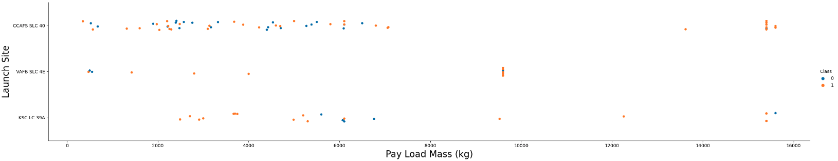
Payload vs. Launch Site
We can see less attempts have been made with payload mass of over 10000kg on sites KSC LC-39A and CCAFS SLC-40. Site VAFB SLC 4E had no launch attempts with payload masses of above 10000kg.
Site KSC LC-39A has more successful launches when using payload masses below 5500kg.
Site VAFB SLC 4E has more successful launches when using heavier payloads above 1000kg and below 10000kg.
Site CCAFS SLC-40 exhibits more successful launches when using heavier payload masses of between 6500kg and 16000kg.

Slide 26
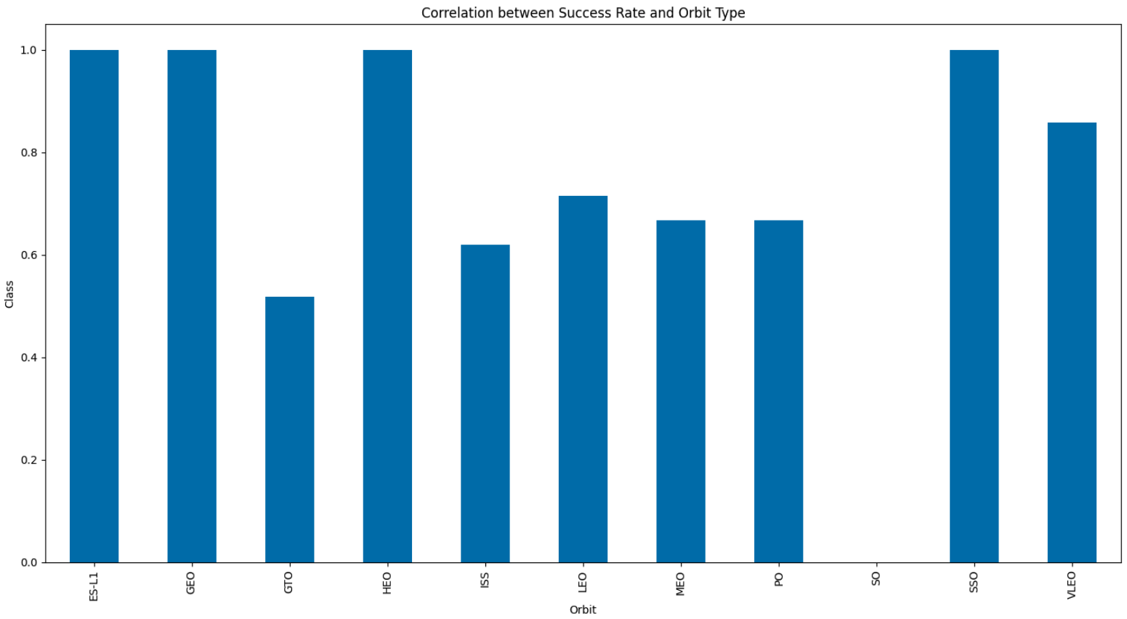
Success Rate vs. Orbit Type
Orbit ES-L1, GEO, HEO and SSO exhibit higher success rates while orbit SO exhibits no success.

Slide 27
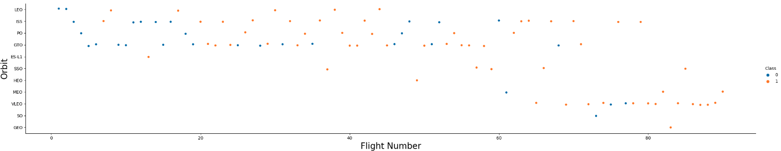
Flight Number vs. Orbit Type
We can see after the initial first two launches, orbit LEO's success is related to number of flights. With more launch attempts, there is increased success.
When it comes to orbits GTO, ISS and PO, no correlation is seen between the launch attempt flight number.

Slide 28
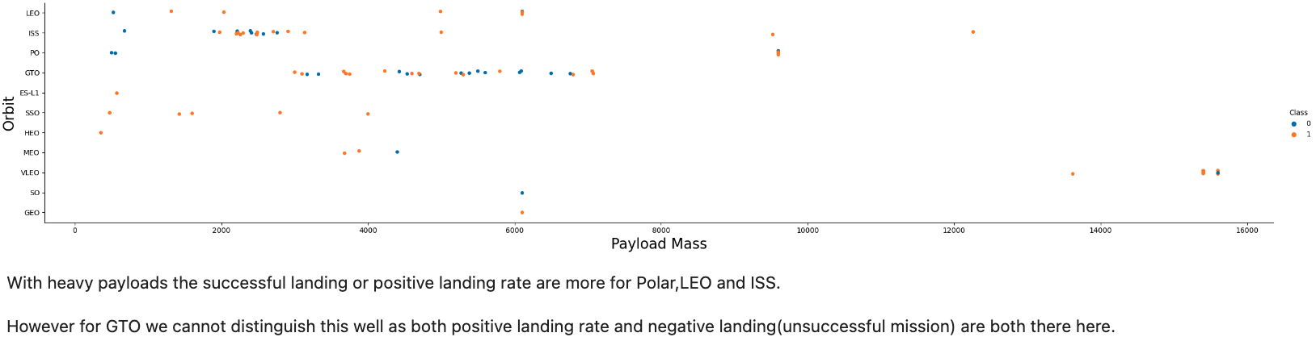
Payload vs. Orbit Type

Slide 29
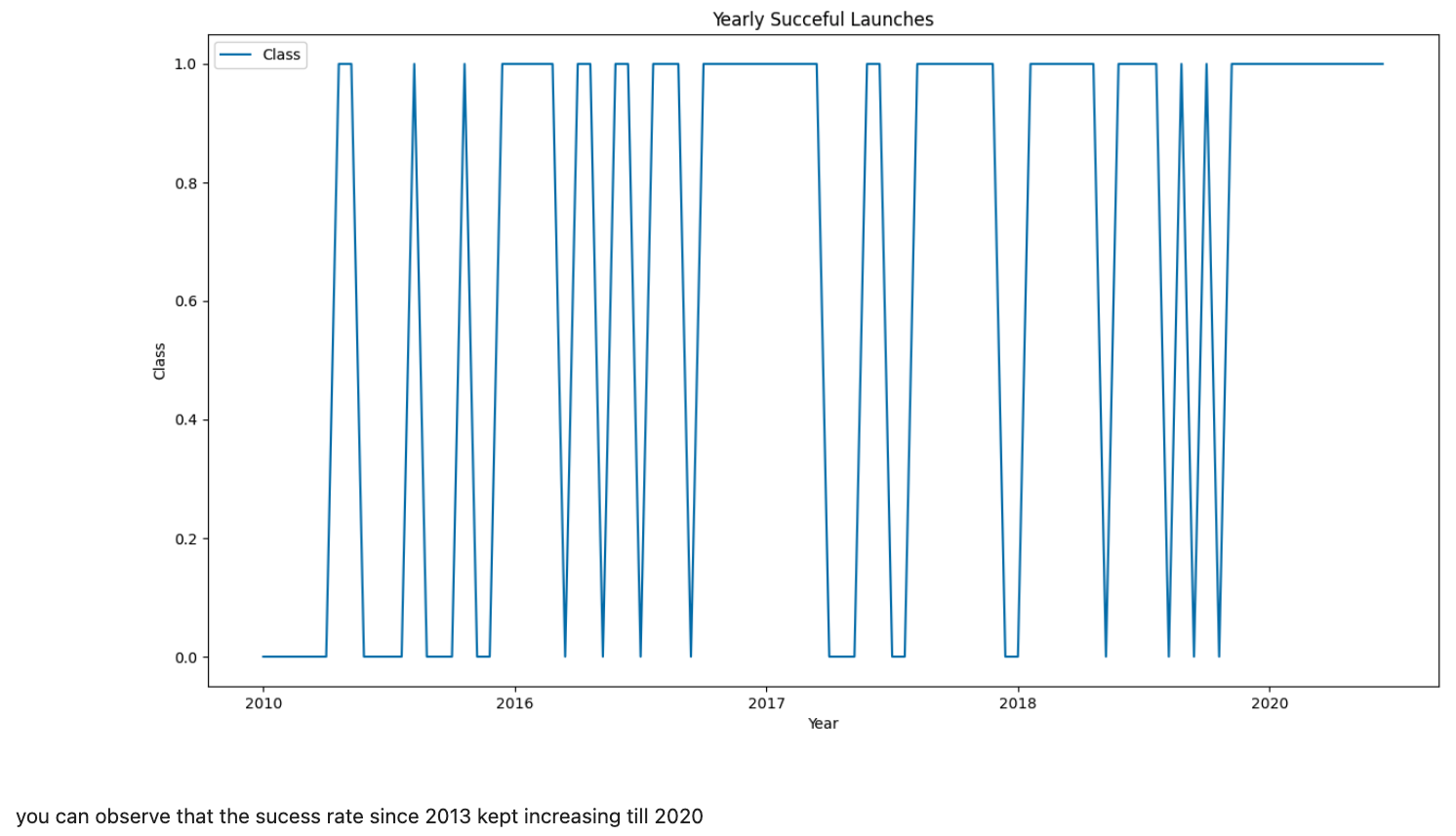
Launch Success Yearly Trend

Slide 30
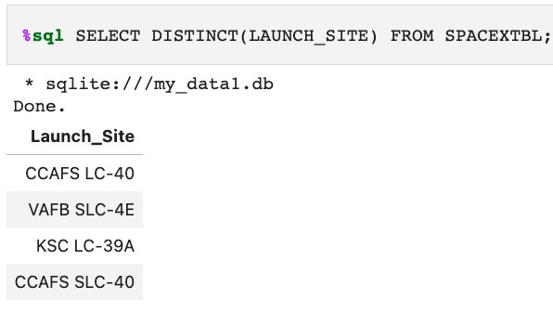
All Launch Site Names
The result of the query shows all the unique space launch sites for falcon 9. There are four sites.

Slide 31
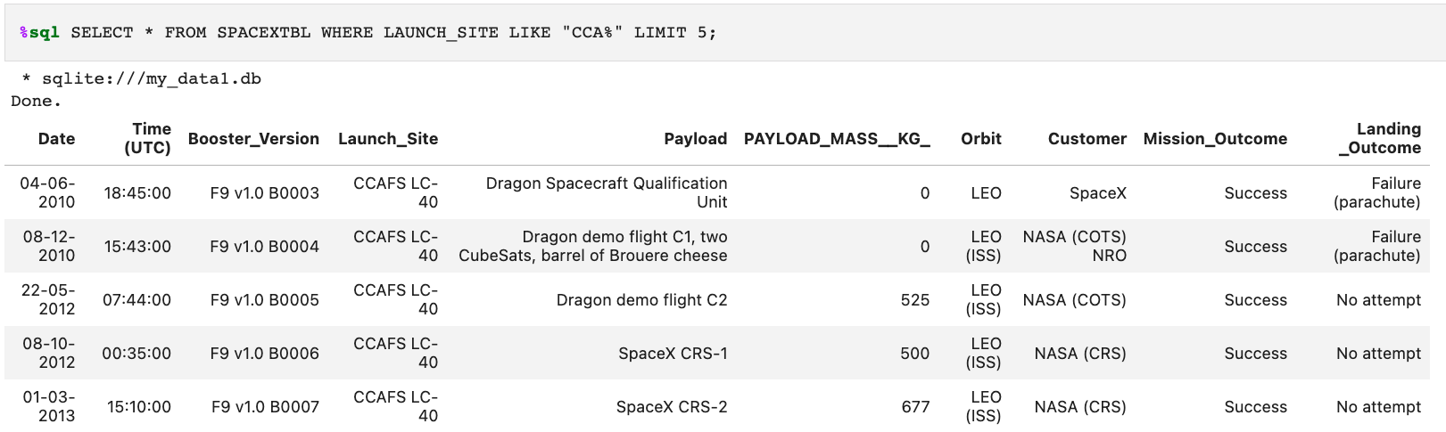
Launch Site Names Begin with 'CCA'
The query here lists the first five records from the data in which the name of the launch sites begins with "CCA". Our earlier visualization EDA had excluded launch site CCAFS LC-40 which this table reveals.

Slide 32
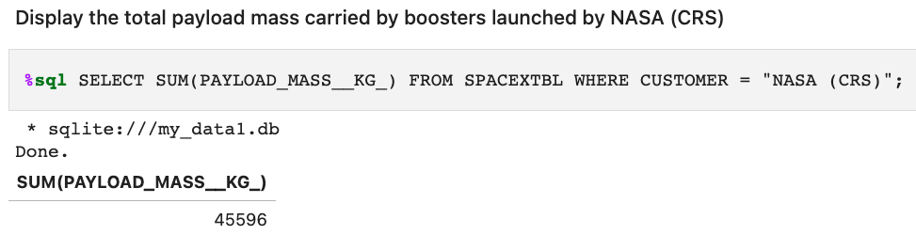
Total Payload Mass
The query here shows the total payload mass carried by boosters carried launched by NASA (CRS).

Slide 33
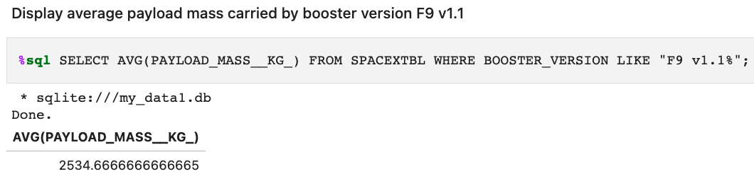
Average Payload Mass by F9 v1.1
This query shows the booster version F9 v1.1 carried an average mass of 2534.67kg payload.

Slide 34
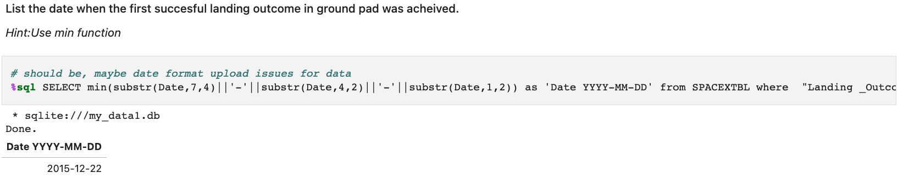
First Successful Ground Landing Date
This query shows the first successful landing outcome in ground pad was achieved on December 22nd, 2015.

Slide 35
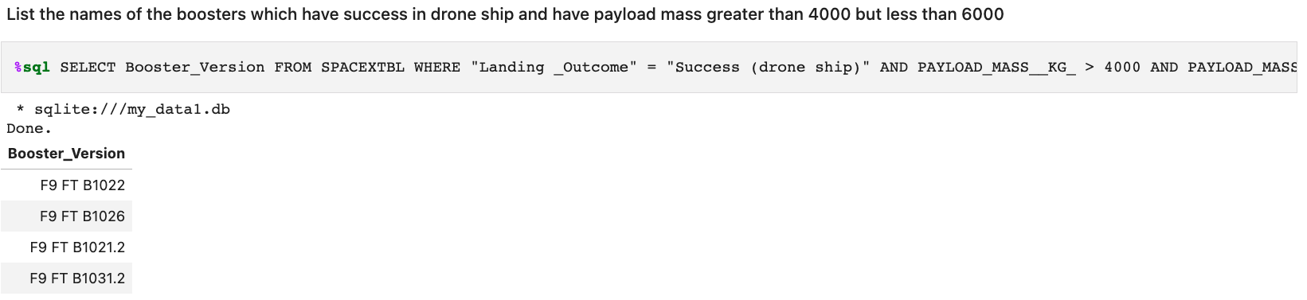
Successful Drone Ship Landing with Payload between 4000 and 6000
This query shows the list of boosters who have had successful landing outcomes on drone ships while carrying payloads of more than 4000kg and less than 6000kg.

Slide 36
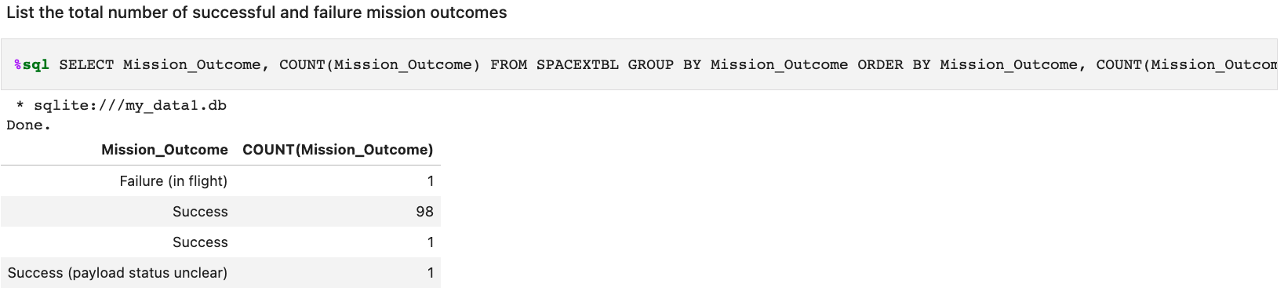
Total Number of Successful and Failure Mission Outcomes
This query summarizes the total number of mission outcomes, i.e. the total number of successful outcomes and failed outcomes.

Slide 37
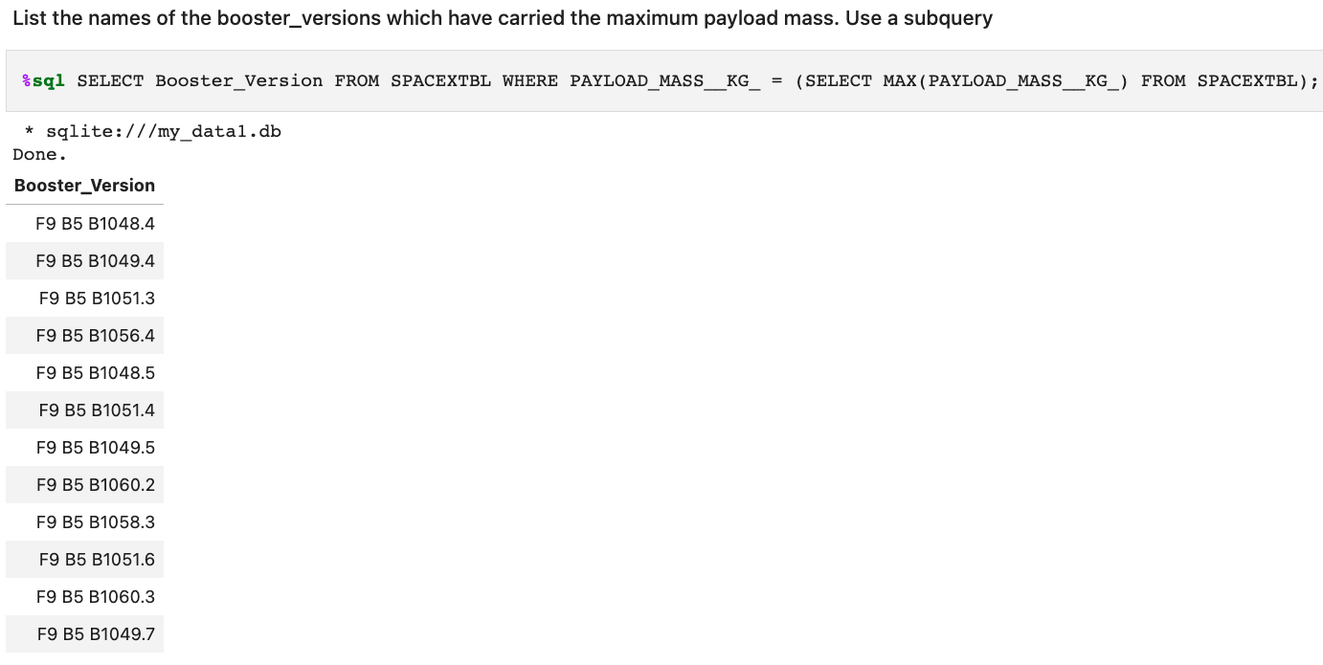
Boosters Carried Maximum Payload
This query shows the list of booster versions which carried the maximum payload.

Slide 38
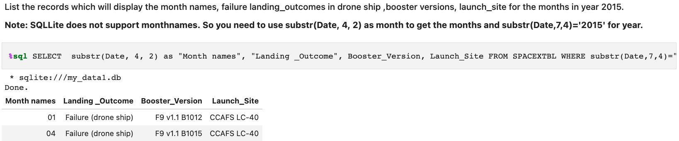
2015 Launch Records
Here we summarized the launch records who've had failed landing outcomes on drone ships for the year 2015. The details include the month of the launch, the booster version used and the launch site.

Slide 39
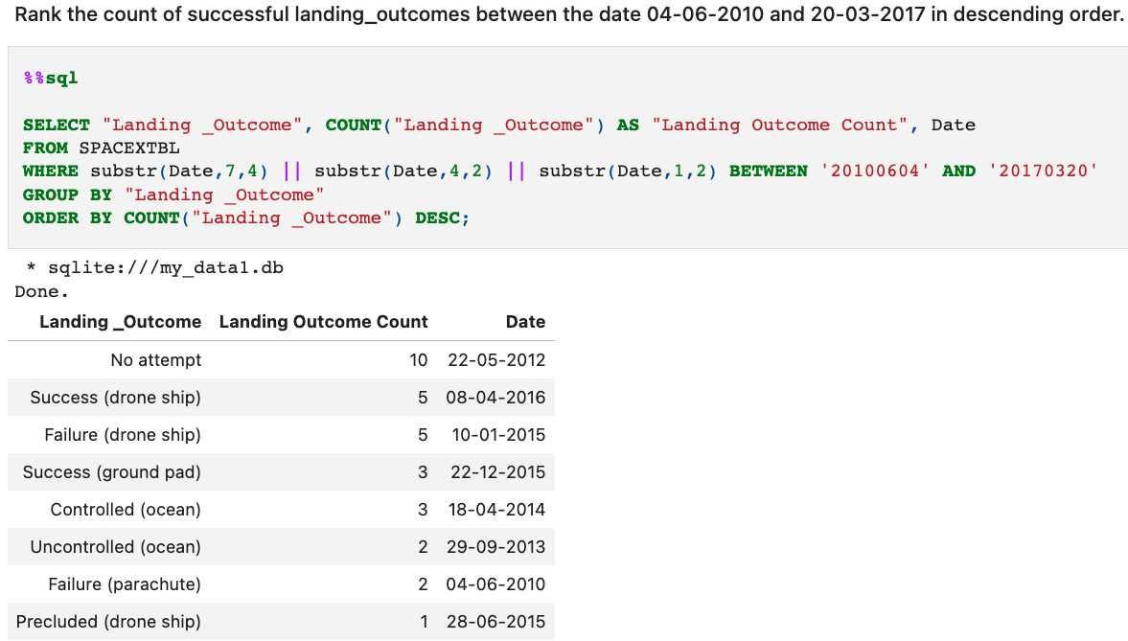
Rank Landing Outcomes Between 2010-06-04 and 2017-03-20
This query counts and groups the landing outcomes and then ranks them in descending order for the time period June 4, 2010 to March 20, 2017.

Slide 40

Section 3

Slide 41
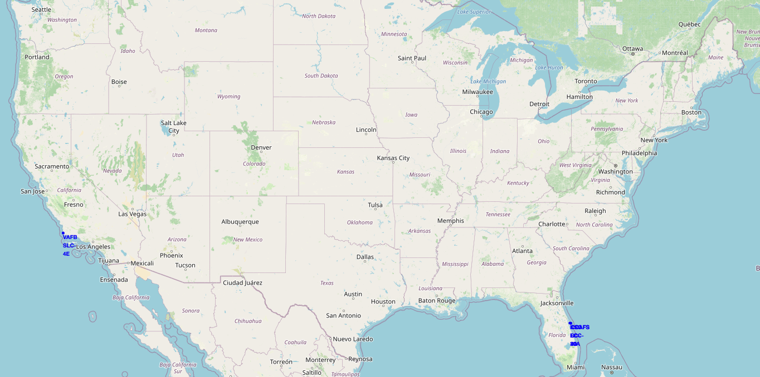
Mapped Location of all Space Mission Launch Sites
The four mission launch sites (CCAFS LC-40, CCAFS SLC-40, KSC LC-39A and VAFB SLC-4E) are marked in blue dots. We can see that all sites are situated very close to a coast and none of them are near the equator
Explain the important elements and findings on the screenshot

Slide 42
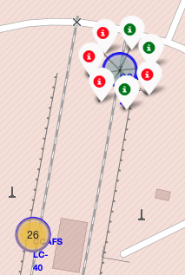
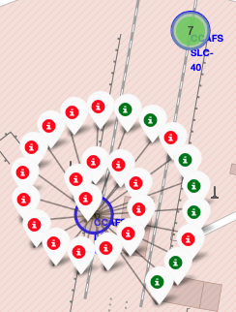
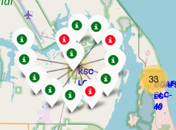
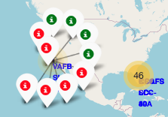
Successful and Failed Launch Outcomes Mapped in Clusters
CCAFS SLC-40 | CCAFS LC-40 | KSC LC-39A | VAFB SLC-4E
The map clustered all the launch outcomes by launch site and identified the failed outcomes in red and the successful outcomes in green.
We can see there has been a lot of launches from site CCAFS LC-40 but launch site KSC LC-39A shows the most successful launch outcomes.

Slide 43
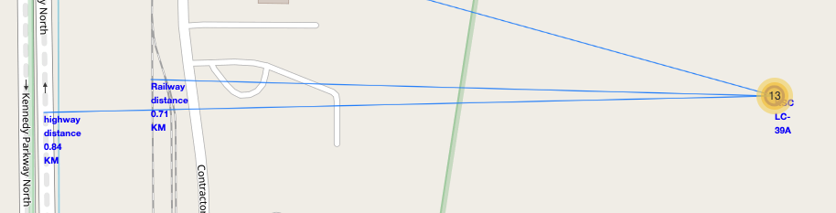
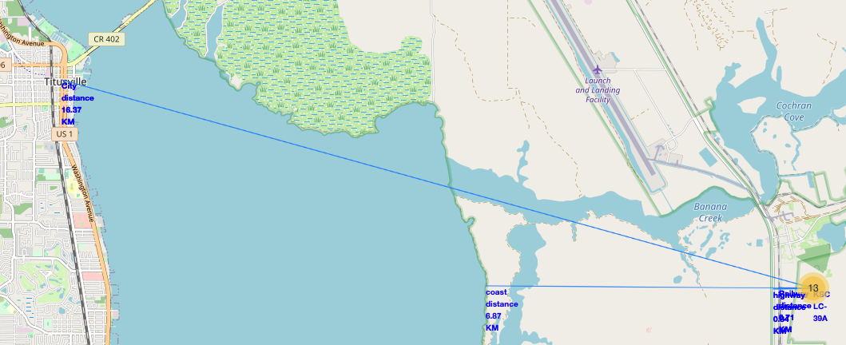
Highway, Railway and City Closest to Launch Site KSC LC-39A
On the map we can see that generally a site is fairly further from a city but closer to a coast. There are also highways and railways nearby making transportation accessible.

Slide 44

Section 4

Slide 45
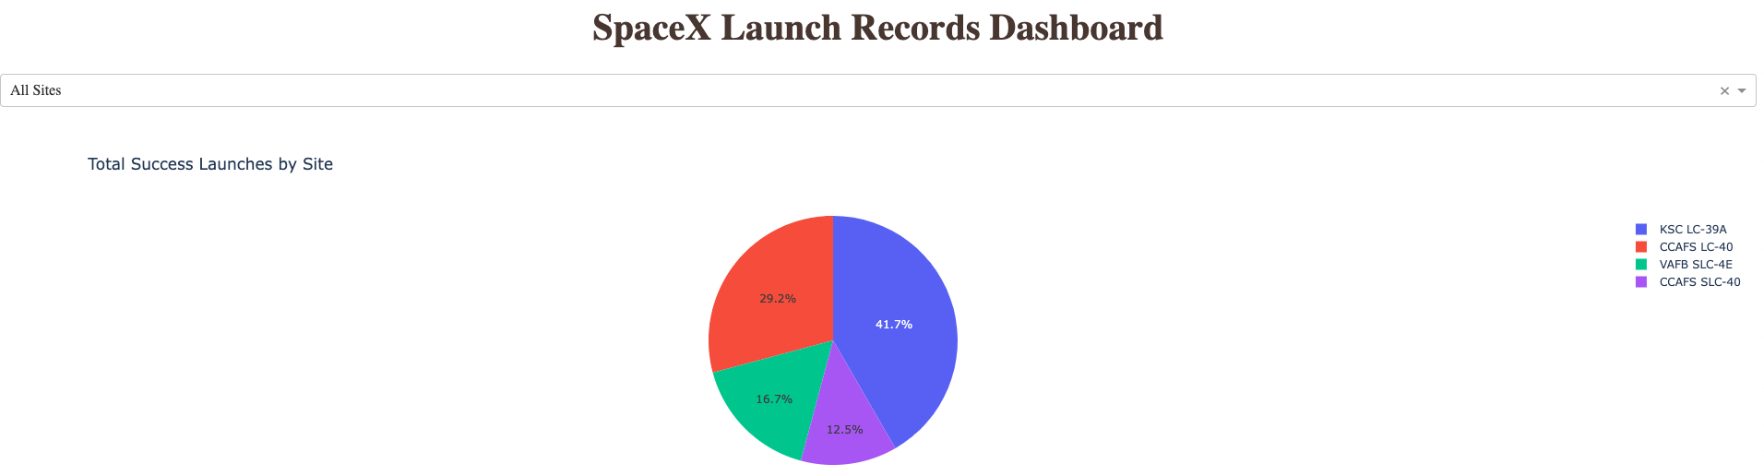
Pie Chart Showing Success Rate of Each Launch Site
This dash shows launch site KSC LC-39A has the highest successful landing outcomes followed by launch site CCAFS LC-40, then VAFB SLC-4E and lastly CCAFS SLC-40 has the least success.

Slide 46
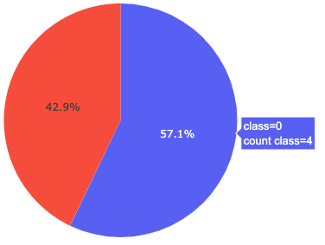
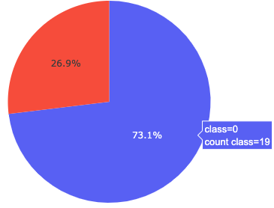
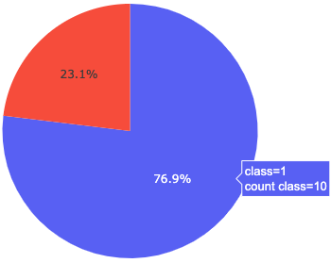
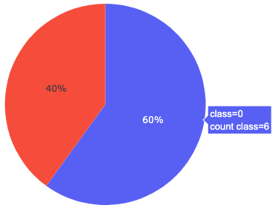
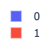
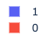
Success to Failed Launch Outcome Ratio Based by Launch Site
CCAFS SLC-40 | CCAFS LC-40 | KSC LC-39A | VAFB SLC-4E
Here we can see launch site the highest successful to failed landing outcome ratio. With the outcome being 76.9% successful to 23.1% failed. Note: class 1 indicates successful outcome and class 0 indicates failed outcome.

Slide 47
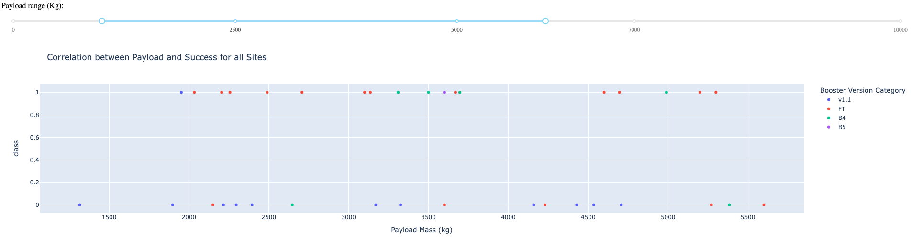
Correlation between Booster Version, Payload Mass and a Successful Outcome
From the first scatter plot, we can see more successful landing outcomes are scattered between payload ranges of 1900kg to 3700kg and as well as between ranges 4600 kg to 5300kg.
We can also see that most of the successful outcomes comes from booster versions FT and in second B4. Booster B4 experiences more success when using payload mass between 3300kg to 3700kg. When using booster version FT, there is more success when using payload masses ranging between 2200kg to 3200kg.

Slide 48

Section 5

Slide 49
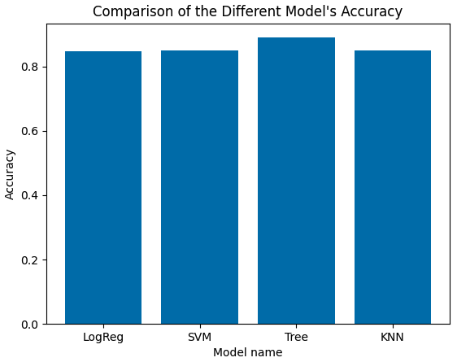
Classification Accuracy
From this bar chart we can see the decision tree is the model with the highest accuracy, making it the ideal model for our classification prediction model.

Slide 50
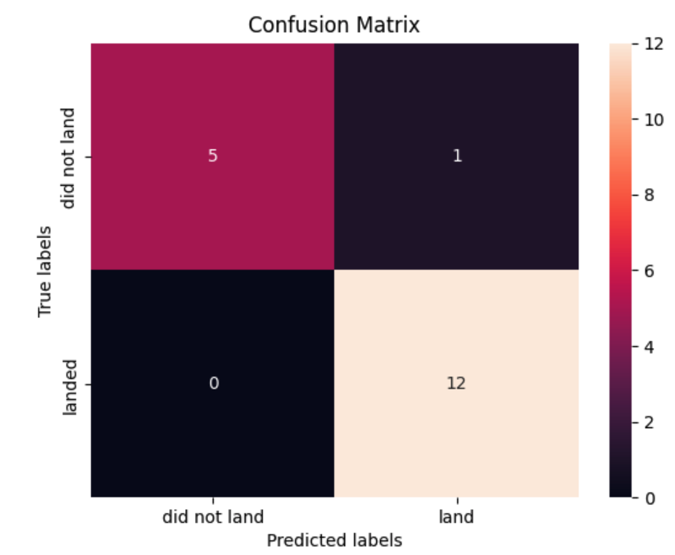
Confusion Matrix
Here we can see the decision tree prediction model has 5 True Negatives, 1 False Positive, 0 False Negatives and 12 True Positives results. With this info the the recall and precision is calculated to be 1.0 and 0.92 respectively. The closer to the value of 1, the better a model is. The decision tree showed higher precision compared to the other models.

Slide 51
Conclusions
This project analysis demonstrates we can obtain a higher odd of successfully landing if we launch from site KSC LC-39A while using a booster version FT and a payload ranging from 3600- 5300kg. Higher than 5500 kg payload with FT booster results in more failed landing.
We also saw the decision tree provided a more accurate predictive model for the classification of a landing outcome.

Slide 52


